Slide 1
EECS 373:
Design of Microprocessor-Based Systems
Timers, count, capture and PWM
Some material from Thomas Schmid, Mark Brehob

Slide 2
Announcements
HW1/Proj1 Status?
Ira Glass: http://vimeo.com/24715531

Slide 3
Today
Background on time and clocking on a processor
SmartFusion clocks and features
How we use timers
Design of a memory-mapped Pulse-Width Modulation (PWM) circuit.

Slide 4
Time in Embedded Systems:
Where do we need accurate time?
Scheduling of computation
  Scheduler in operating systems
  Real time operating systems
Signal sampling and generation
  Audio sampling at 44.1 kHz
  TV/video generation (sync, vsync)
  Pulse Width Modulated (PWM) signals
Communication
  Media Access Control (MAC) protocols
  Modulation
Navigation
  GPS

Slide 5
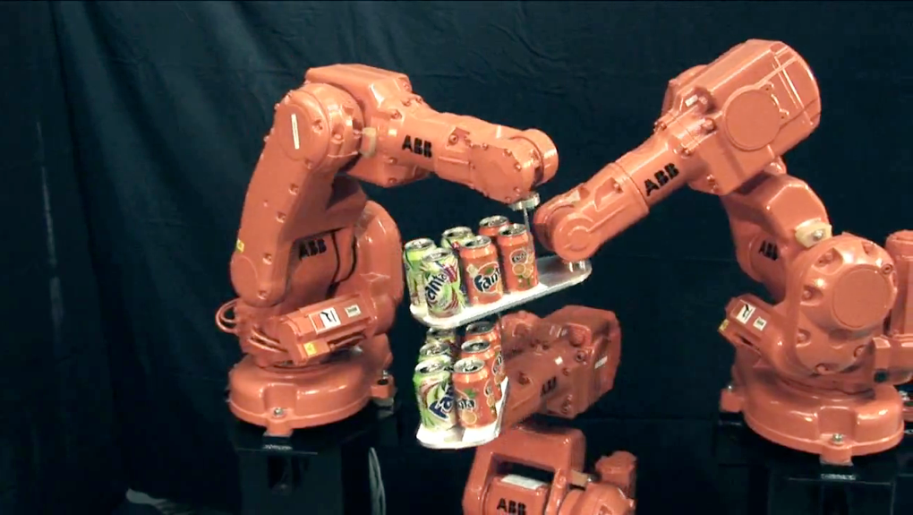
Fine grain motion control
http://www.youtube.com/watch?v=SOESSCXGhFo

Slide 6

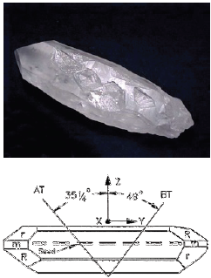
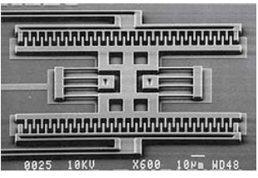
Clock generation and use
Resonating element/Driver:
  Quartz crystal can be made to resonate due to Piezoelectric effect.
    Resonate frequency depends on length, thickness, and angle of cut.
    Issues: Very stable (<100ppm) but not all frequencies possible.
  MEMS Resonator
    Arbitrary frequency, potentially cheap, susceptible to temperature variations.
  Others:
    Inverter Ring, LC/RC circuits, Atomic clock, and many more.

Slide 7
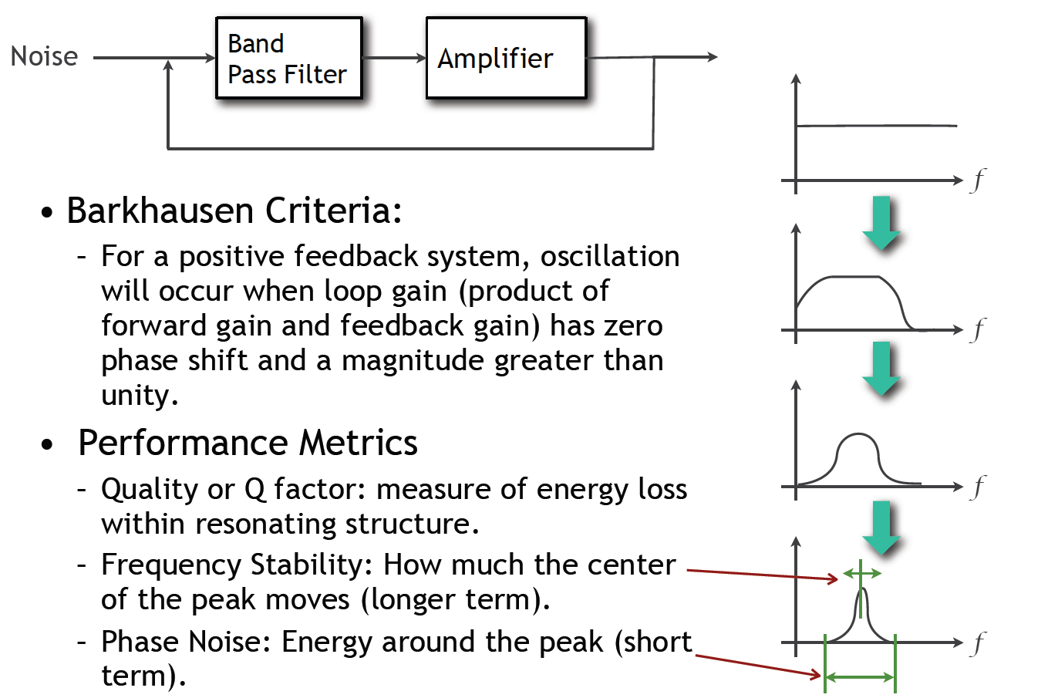
Clock Driver

Slide 8
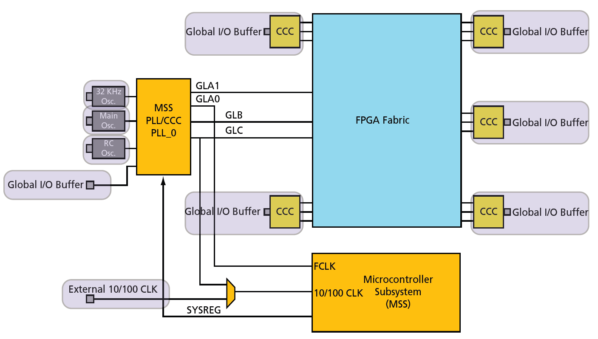
SmartFusion Clock Hierarchy
Original figure from http://www.actel.com/documents/SmartFusion_MSS_UG.pdf

Slide 9
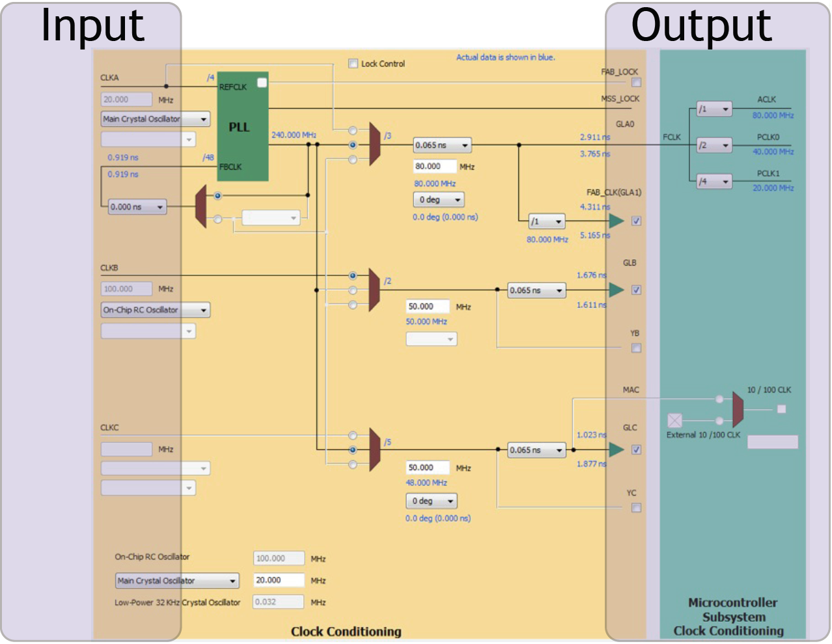
MSS clock Configurator

Slide 10
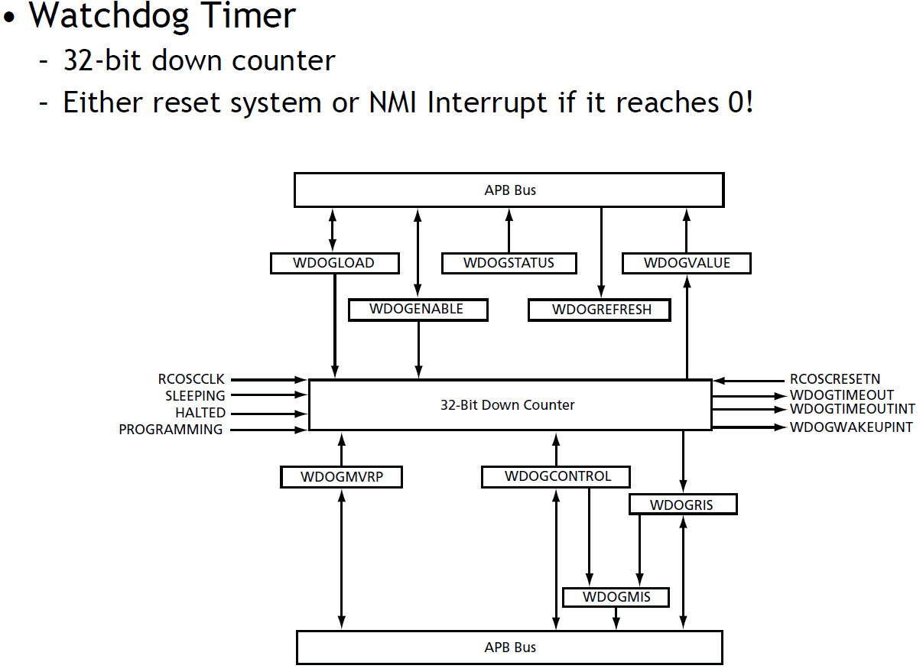
Timers on the SmartFusion

Slide 11
Timers on the SmartFusion
SysTick Timer
  ARM requires every Cortex-M3 to have this timer
  Essentially a 24-bit down-counter to generate system ticks
  Has its own interrupt
  Clocked by FCLK with optional programmable divider
See Actel SmartFusion MSS User Guide for register definitions

Slide 12
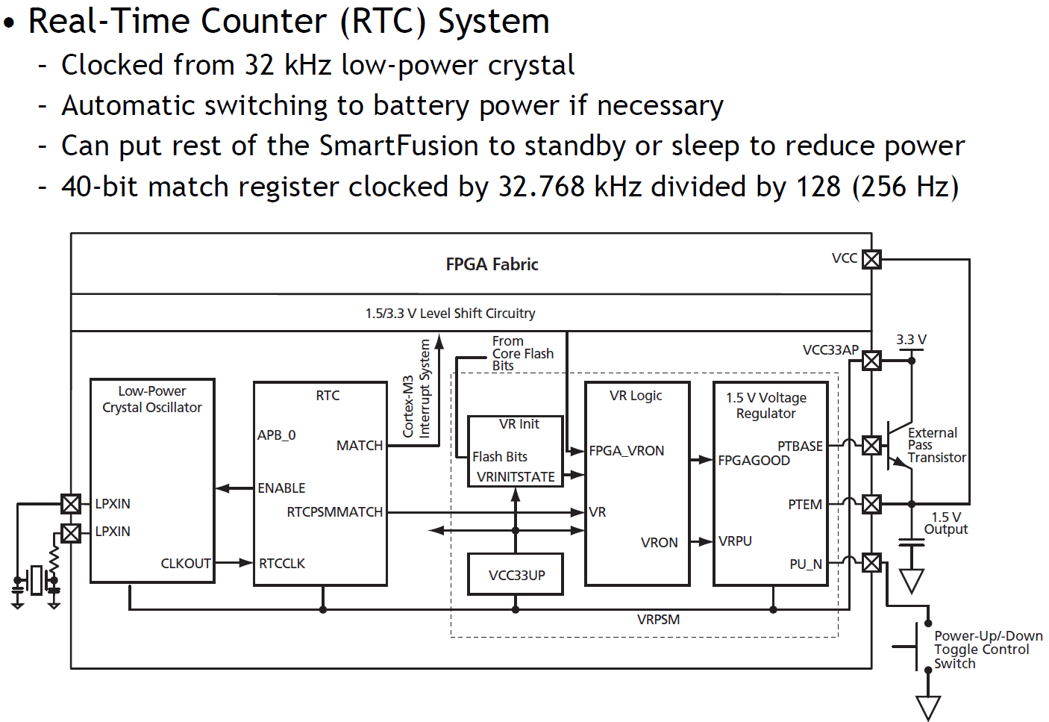
Timers on the SmartFusion
http://www.actel.com/documents/SmartFusion_MSS_UG.pdf

Slide 13
Timers on the SmartFusion
System timer
  “The System Timer consists of two programmable 32-bit decrementing counters that generate interrupts to the ARM® Cortex™-M3 and FPGA fabric. Each counter has two possible modes of operation: Periodic mode or One-Shot mode. The two timers can be concatenated to create a 64-bit timer with Periodic and One-Shot modes. The two 32-bit timers are identical”
http://www.actel.com/documents/SmartFusion_MSS_UG.pdf

Slide 14
Features of Timers a.k.a. “terms you need to know”
Time is kept in the hardware counter
  Resolution: How often the hardware counter is updated.
  Precision: The smallest increment the software can read the counter.
  Accuracy: How close we are to UTC
  Range: The counter reads a value of (f*t) mod 2^{n}. Range is the biggest value we can read.
UTC is Coordinated Universal Time (French is Temps Universel Coordonné). I just work here…

Slide 15
Who cares?
There are two basic activities one wants timers for:
  Measure how long something takes
    “Capture”
  Have something happen every X time period.
    “Compare”

Slide 16
Example #1 -- Capture
FAN
  Say you have a fan spinning and you want to know how fast it is spinning. One way to do that is to have it throw an interrupt every time it completes a rotation.
    Right idea, but might take a while to process the interrupt, heavily loaded system might see slower fan than actually exists.
    This could be bad.
  Solution? Have the timer note immediately how long it took and then generate the interrupt. Also restart timer immediately.
Same issue would exist in a car when measuring speed of a wheel turning (for speedometer or anti-lock brakes).

Slide 17
Example #2 -- Compare
Driving a DC motor via PWM.
  Motors turn at a speed determined by the voltage applied.
    Doing this in analog land can be hard.
      Need to get analog out of our processor
      Need to amplify signal in a linear way (op-amp?)
    Generally prefer just switching between “Max” and “Off” quickly.
      Average is good enough.
      Now don’t need linear amplifier—just “on” and “off”. (transistor)
  Need a signal with a certain duty cycle and frequency.
    That is % of time high.

Slide 18
Bonus slides

Slide 19
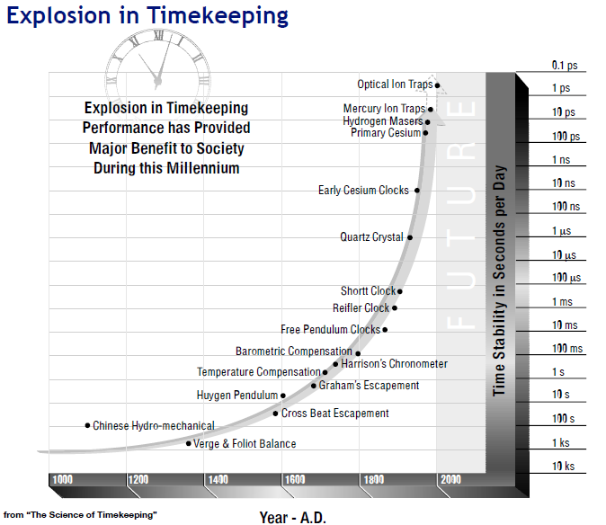

Slide 20
Timers and clock division
Real quick define:
  Duty cycle
  PWM
  Resolution
  Range
  Precision
  Prescalar
  “Capture”
  “Compare”
Using high-level devices, draw a circuit which takes in a 100MHz clock with a 10% duty cycle and generates a 5MHz clock with 50% duty cycle.
How are these two topics related?
We can use timers to divide clocks.
Timers _are_ just counters.

Slide 21
Virtual timers
You never have enough timers.
  Never.
So what are we going to do about it?
  How about we handle in software?

Slide 22
Virtual Timers
Simple idea.
  Maybe we have 10 events we might want to generate.
    Just make a list of them and set the timer to go off for the first one.
      Do that first task, change the timer to interrupt for the next task.

Slide 23
Problems?
Only works for “compare” timer uses.
Will result in slower ISR response time
  May not care, could just schedule sooner…

Slide 24
Implementation issues
Shared user-space/ISR data structure.
  Insertion happens at least some of the time in user code.
  Deletion happens in ISR.
    We need critical section (disable interrupt)
How do we deal with our modulo counter?
  That is, the timer wraps around.
  Why is that an issue?
What functionality would be nice?
  Generally one-shot vs. repeating events
  Might be other things desired though
What if two events are to happen at the same time?
  Pick an order, do both…

Slide 25
Implementation issues (continued)
What data structure?
  Data needs be sorted
    Inserting one thing at a time
  We always pop from one end
  But we add in sorted order.

Slide 26
